Slide 1
Review of Basic Engineering Distributions and Associated Expressions
Unit 4B
Fall 2022

Slide 2
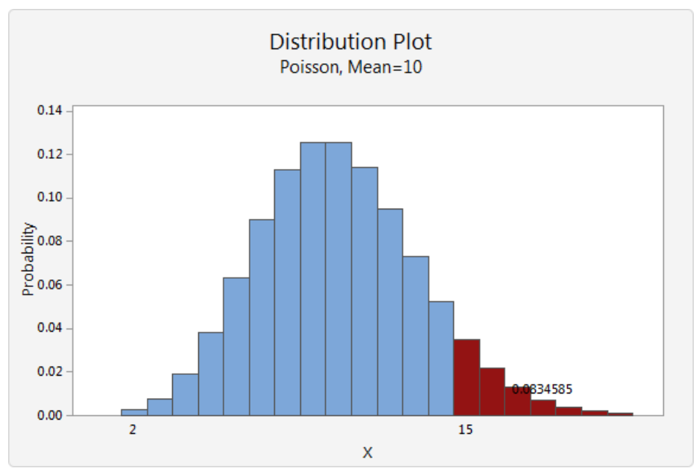
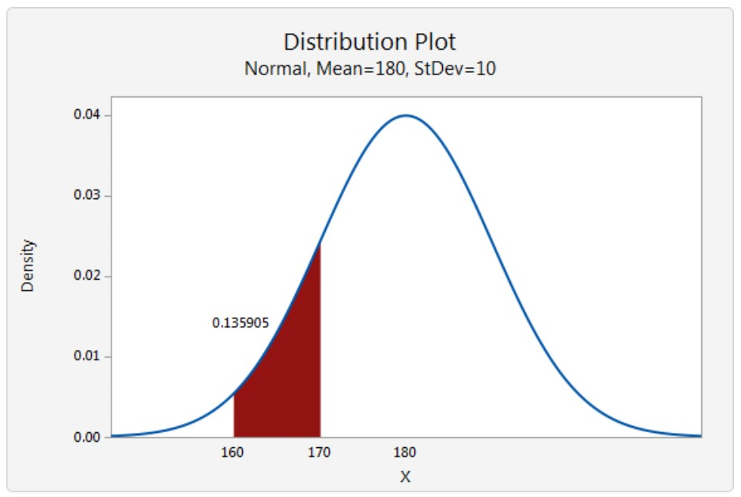
Discrete vs. Continuous Distributions
Discrete
Probability that x is a certain exact value
E.g. Binomial, Poisson
Continuous
Probabilities of all possible values of x (infinite and uncountable)
E.g. Normal, Uniform, Exponential, Weibull, Gamma

Slide 3
Discrete Distributions
Probability Mass Function (pmf), f_{X}(x_{i})
Probability function for discrete values of x_{i}. An example is the example of Annual Rainfall Intensity shown before.
p_{X}(x_{i}) = f_{X}(x_{i}) = P(X = x_{i})
Cumulative Distribution Function (cdf), F_{X}(x) :
Constructed by summing over all x_{i ,}≤ x (just like summing over all frequencies in the F-N risk profile).
.

Slide 4
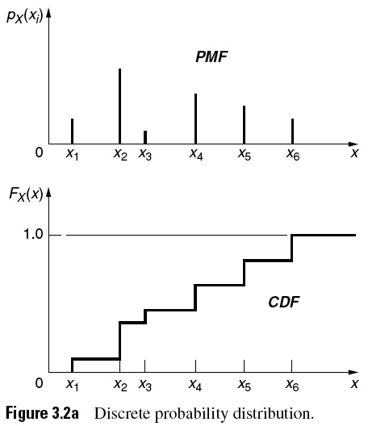
03_02a
Probability Mass Function
Cumulative Distribution Function
(Pr Axiom 2)
(Ang & Tang, PCE)
Notes:
03_02a.jpg

Slide 5
Bernoulli Process/Sequence
Events are often encountered in engineering that occur or not occur, and they may reoccur in a sequence of events or trials in which there are only 2 outcomes (occur or not occur).
Bernoulli sequence model requires:
1. Occurrence or non-occurrence (binary states, e.g. fail/not fail, pass/not pass, yes/no)
2. Trials are taken to be independent of each other
3. Probability of occurrence of an event in each trial is approximately the same (memoryless property)

Slide 6
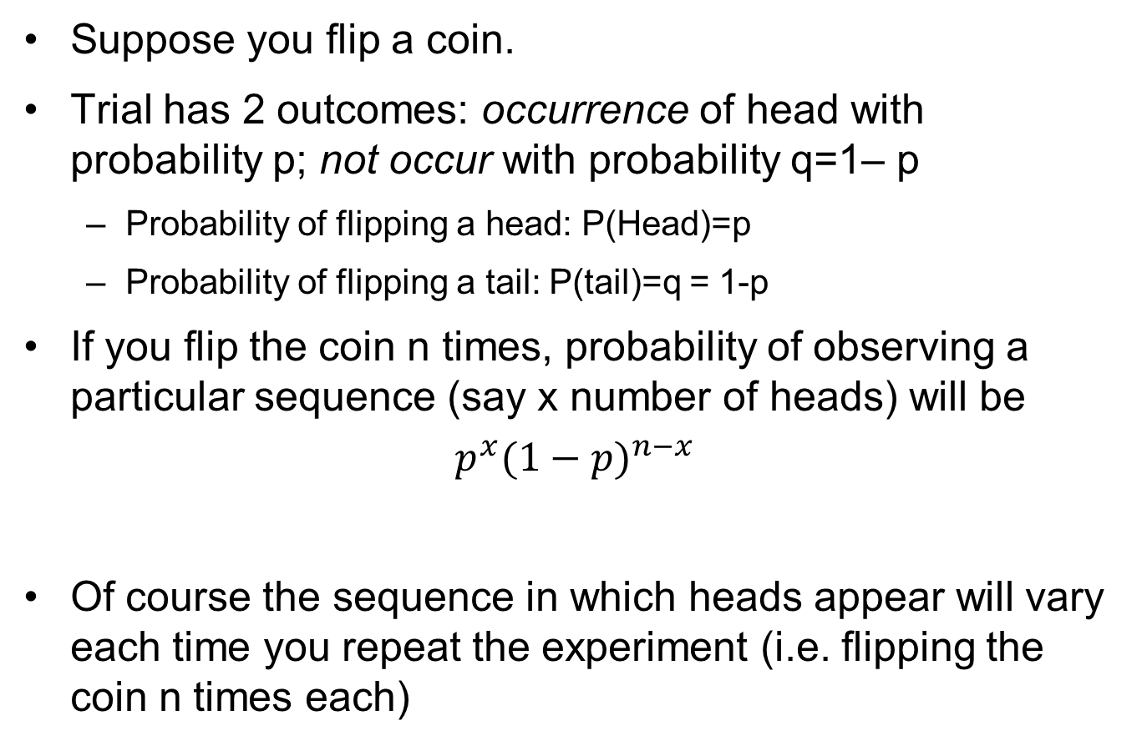
Bernoulli measure
Suppose you flip a coin.
Trial has 2 outcomes: occurrence of head with probability p; not occur with probability q=1– p
Probability of flipping a head: P(Head)=p
Probability of flipping a tail: P(tail)=q = 1-p
If you flip the coin n times, probability of observing a particular sequence (say x number of heads) will be
$$p^{x}{(1−p)}^{n−x}$$
Of course the sequence in which heads appear will vary each time you repeat the experiment (i.e. flipping the coin n times each)

Slide 7
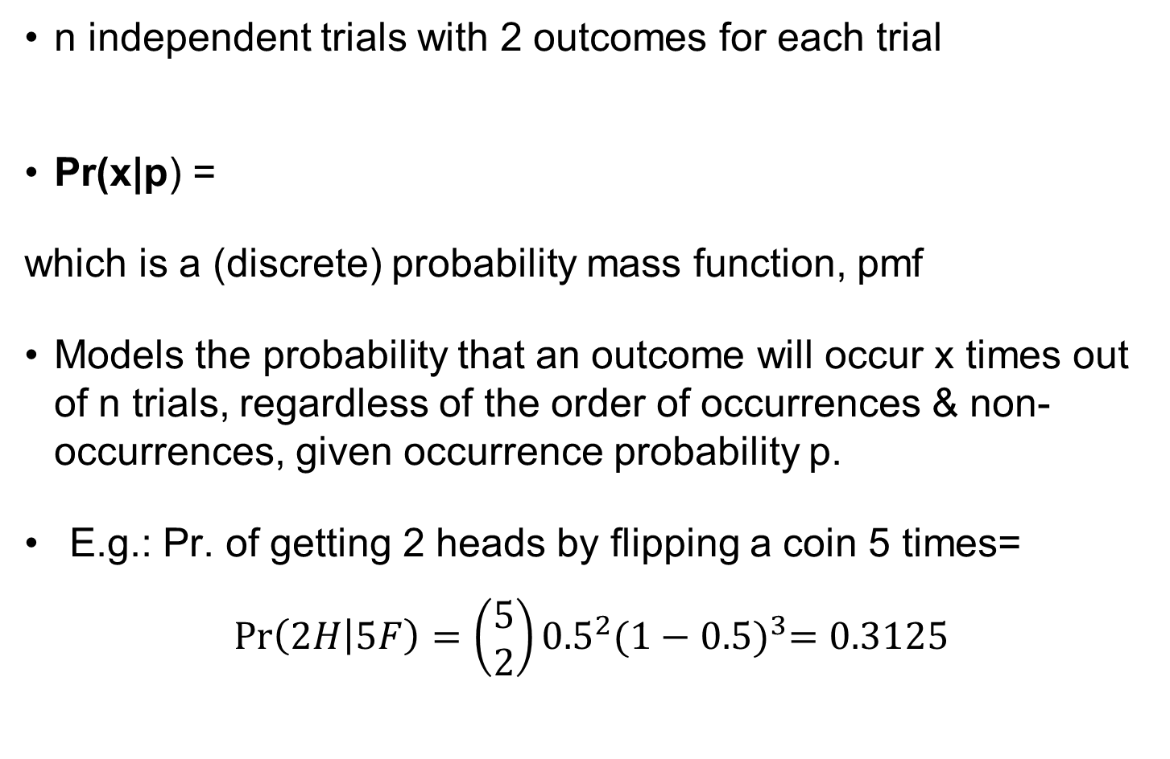
Binomial Distribution (Derived from Bernoulli Sequence)
n independent trials with 2 outcomes for each trial
Pr(x|p) =
which is a (discrete) probability mass function, pmf
Models the probability that an outcome will occur x times out of n trials, regardless of the order of occurrences & non-occurrences, given occurrence probability p.
E.g.: Pr. of getting 2 heads by flipping a coin 5 times=
$$\operatorname{Pr}\left(2H | 5F\right)=\left(\begin{matrix}5 \\ 2\end{matrix}\right){0.5}^{2}{(1−0.5)}^{3}=0.3125$$
, x = 1, 2, …, n
Notes:
A binomial distribution is the sum of independent and identically distributed Bernoulli random variables. And, in general, if there are nn Bernoulli trials, then the sum of those trials is binomially distributed with parameters nn and pp.

Slide 8
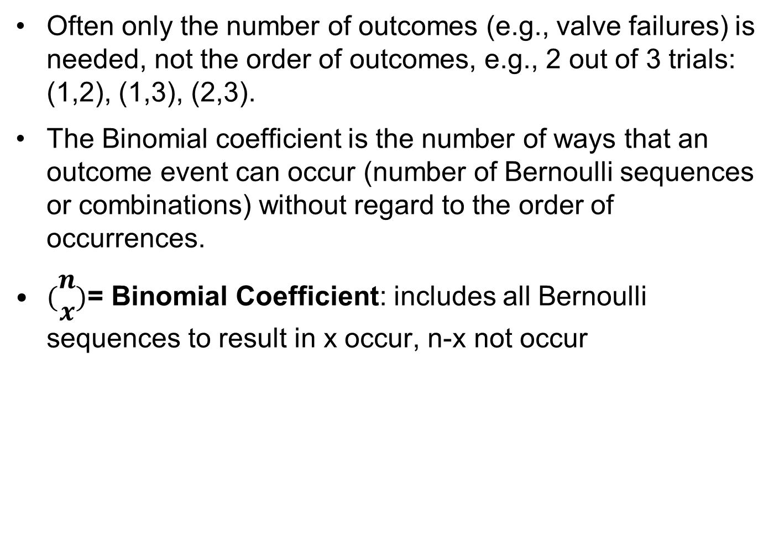

Binomial Coefficient
Often only the number of outcomes (e.g., valve failures) is needed, not the order of outcomes, e.g., 2 out of 3 trials: (1,2), (1,3), (2,3).
The Binomial coefficient is the number of ways that an outcome event can occur (number of Bernoulli sequences or combinations) without regard to the order of occurrences.
$(\begin{matrix}n \\ x\end{matrix})$= Binomial Coefficient: includes all Bernoulli sequences to result in x occur, n-x not occur
$$\left(\begin{matrix}n \\ x\end{matrix}\right)=\frac{n!}{x!\left(n−x\right)!}= \frac{1×2×3×…×n}{(1×2×3×…×x)(1×2×3×…×(n−x)}$$
$$n!=1×2×3×…×n$$

Slide 9
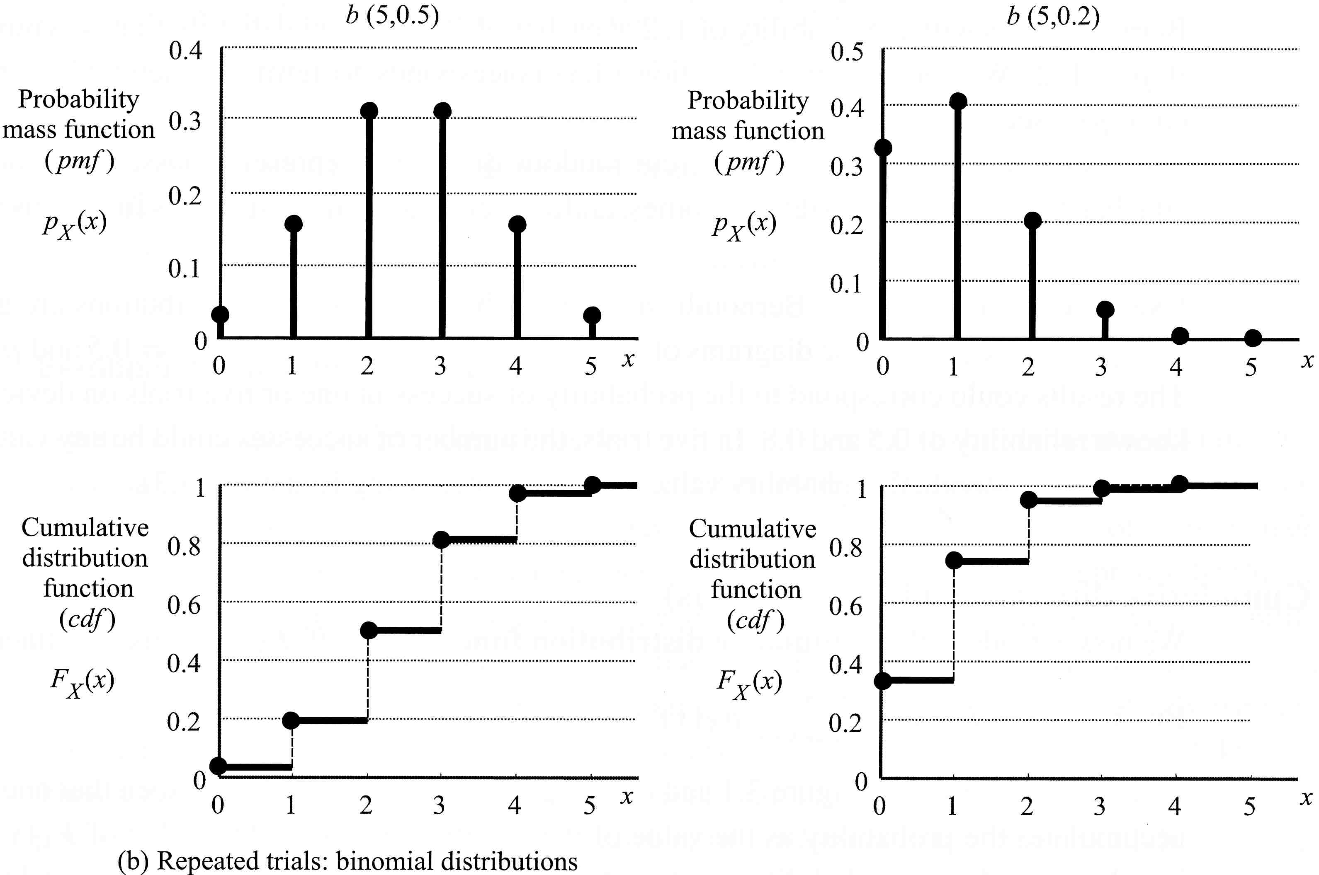
(Jordaan, 2005, Fig 3.1)
p = 0.5
Asymmetric coin (p = 0.2)
A cumulative distribution shows the rate of accumulation due to the pmf.
Binomial Distribution showing probability of x heads in 5 tosses of a coin
Notes:
Probability of m heads in 5 tosses of a coin

Slide 10
Binomial Distribution
Mean, μ = np; Variance, σ² = n(pq); cov = σ/μ
Note that the mean and variance of the Binomial distribution is n times the mean and n times the variance of a Bernoulli sequence as expected for the n Bernoulli sequences or trials modeled by the Binomial distribution.
The Binomial distribution represents n independent and identically distributed (iid) Bernoulli random variables.

Slide 11
Binomial Dist., Example, 1
1. In a plant are two identical generators A & B for emergency ac power. One generator by itself has sufficient capacity. History records 1 failure for 100 demands for each generator.
For risk assessment and assuming independence, what is the probability on a specific demand that both generators will have conditionally failed when needed?
Solution:
Prob. of failure of A & B= p=n/N = 1/100 = 0.01
Prob. of success=1– p =0.99
Probability of both generators failing = Pr(A∩B)
= Pr(A) Pr(B) (A, B assumed independent)
= (0.01)(0.01) = 0.0001 (Simultaneous failure on demand)

Slide 12
Binomial Dist., Example, 2
2. Two identical generators A & B for emergency ac power supply. One generator can supply needed ac power.
If there are 12 demands/year for emergency power, what is the probability of at least 1 failure/year for A? (A is demanded first.)
Solution:
At least one failure means 1 or more failures of A in a year.
Pr of at least 1 failure of A in a year is the complement of no failures in 12 demands (Pr Axiom 2).
First calculate the probability of 0 failures out of 12 demands.

Slide 13
Binomial Dist., Example 2
Probability of not failing in 12 demands in 1 yr:
Binomial: , X = 0 failures:
From data: p (fail) = 0.01; 1– p (success) =0.99
0!=1
Pr of no failures in 12 demands=
Pr of at least 1 failure of A in a year is the complement of no failures in 12 demands. Write the logic expression: Pr(X ≥ 1) = 1 – Pr(X < 1) = 1 – Pr(X = 0)
= 1- 0.886 = 0.114

Slide 14
Binomial Dist., Example, 3
3. Same 2 identical generators A&B for emergency ac.
For 12 demands/yr, find Pr of both A, B fail simultaneously on demand at least 1 time/yr.
Binomial, p = success:
First find Probability of 0 simultaneous failures in 12 demands:
$$\operatorname{Pr}\left(X=0\right)=(\begin{matrix}12 \\ 0\end{matrix})({0.0001)}^{0}{\left(0.9999\right)}^{12}=0.9988$$
Probability of at least 1 failure of A and B/year:
P(X ≥ 1) = 1 – P(X < 1) = 1 – P(X = 0) = 1– 0.9988 = 0.0012
Compare with the 1 co-failure in 12 demands case: Do you agree?

Slide 15
Poisson Distribution, Homogeneous
An important event category is the Pr of each number of relatively rare events x that could occur in t (where t = time period, distance, area, volume etc.). E.g. no. of failures within a year.
The discrete Poisson distribution has 1 parameter ρ = λt, where λ is the occurrence rate or intensity parameter of relatively rare random events.
The Poisson is asking for the probability of a number of successes during a period of time while the binomial is asking for the probability of a certain number of successes for a given number of trials..

Slide 16
Poisson Discrete Distribution
Poisson is derived from the Binomial Distribution when number of successes, x, is small, compared to the number of attempts, n:
x << n, or, p(=x/n) ≤ 0.1. Larger errors occur for p > 0.1
Represents integral number of events (or objects) randomly dispersed in time (or space)
The pmf (probability mass function) is
Mean x (# events/objects) = ρ ; Variance = ρ ; cov

Slide 17
Poisson Example, A
A plant loses electrical power from a utility grid outside the plant at a rate λ = 1/year.
Estimate the probability that no power outage will occur over t = 3 years.
Estimate that at least 2 outages will occur. (As shown earlier, it is easier first to calculate the probability that 0 or 1 outage will occur and then employ the complement).
Solution:
First find ρ = λt, Poisson distribution mean and variance.
λ = 1/year (rate), t = 3 years, ρ = λt = 3 = mean = variance

Slide 18
Poisson Example, Solution A
No power outage will occur over 3 yr, x = 0:
2. One power outage over 3 yr, x = 1:
Probability of at least 2 outages over 3 yr:
High Pr for X ≥ 2 is reasonable, because mean value ρ = λt = 3

Slide 19
Poisson Example, B
Inspections of a high pressure pipe show that on average, λ = 2 pits per meter of pipe (Pits indicate corrosion).
If the pitting intensity is constant and about the same for all similar pipe, estimate the probability that there are < 5 pits in a 10 m pipe section (i.e. t=10). What is the expected number of pits (mean) in the section? Begin Poisson problems by finding ρ = λt for a fixed t.
Estimate the Pr that there are 5 or more pits.
Solution:
We must calculate the Pr of 0 to 4 pits in the pipe section.
Use the single parameter Poisson distribution for #occurrences n such that p = x/n ≤ 0.1.

Slide 20
Poisson Example, B, Solution
Calculate the probability that there are < 5 pits in a 10 m pipe section.
Rate λ = 2/m, Intensity t = 10 m, ρ = λt = 20.
2. Probability for 5 or more pits,
(very low for < 5 since expected # of pits =mean = 20 pits in 10 m)

Slide 21
Severe Rainstorms
Severe rainstorms in an area over the last 20 years indicated a mean of 4/yr within t = 1 yr (ρ = 4 ). From the Poisson model, the probability of no severe rainstorms for the next year is:
The Pr of exactly 4 rainstorms next year is:
Note: Variance = 4, σ = 2, cov = 2/4 = 0.5. The distribution mean ρ = 4, but the Pr of exactly 4 storms is only 0.195, because of the wide variance of the observed number of rainstorms! This understanding requires thinking in distributions, not just point values often taken from a broad distribution with a relatively low probability of each point value!

Slide 22
Severe Rainstorms
The prediction of 4 or more severe rainstorms during the next year is (using Pr Axiom 2):
Based on the historic data, the pmf of X or the probability of x severe rainstorms in 1 year in this area for X = 0 to 12 is shown in the following figure as modeled by the Poisson distribution with parameter ρ = 4 = λt = (4/yr)(1yr) = mean = Variance.
Write the logic expression:
X=0
X=1
X=2
X=3

Slide 23
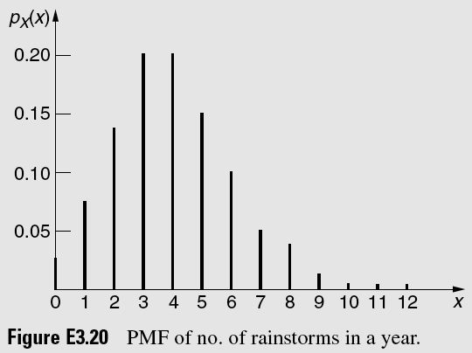
E_03_20
A Decision Based only on Mean Value Ignores
Crucial Data! Example of Grand Forks Red River Flood!
Needed for Mitigation plans:
P(X ≥ 4) = 1 – P(X ≤ 3) = 1 – 0.43 = 0.57
(Ang & Tang, PCE)
Notes:
E_03_20.jpg

Slide 24
Discrete vs. Continuous Distributions
Discrete
Probability that x is a certain exact value
E.g. Binomial, Poisson
Continuous
Probabilities of all possible values of x (infinite and uncountable)
E.g. Normal, Uniform, Exponential, Weibull, Gamma

Slide 25
Continuous Distributions
Probability Density Function (pdf) = f_{X}(x). An example is the ‘bell-shaped curve’ of the Normal pdf,
Cumulative Distribution Function (cdf)
An example is a table of std. Normal cdf values to find the Pr of an area under a section of the Normal (Gaussian) distribution pdf curve
pdf
cdf
Slope of cdf is the pdf

Slide 26
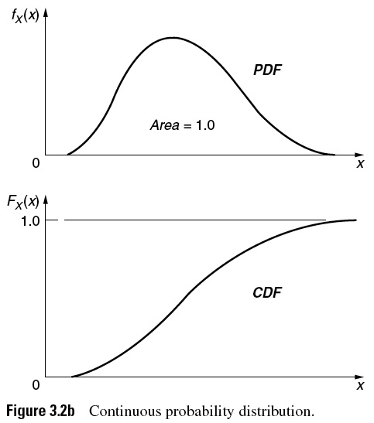
03_02b
Probability Density Function
PDF extremum
Every area under a pdf corresponds to a point Pr value on the cdf curve.
Total
area
x’
Cumulative Distribution Function
Inflection Point
point
x’
(Ang & Tang, PCE)
Notes:
03_02b.jpg

Slide 27
Sample Data Center Measures
(Sample Measures vs. Population Measures)
Sample average, average of observations, ; estimate of unknown population mean, µ
Mean, average of population values, µ
Median, half data below 0.5 and half data above 0.5 : less influenced by outliers than is sample mean,
Mode, highest probability of pdf (or greatest frequency of pmf)
n, sample size or number of equally weighted observations
Mean =

Slide 28
Mean Value of a Parameter
The mean or expected value of X, E(X) for discrete:
The mean or expected value of X, E(X) for continuous:
The population mean, μ, is a central measure of the probability distribution of X

Slide 29
Variance, a Measure of Distribution Width
Population variance, , often unknown but can be estimated
Sample variance, gives an estimate of from equally weighted observations (POI), or using p(x_{i}) as the pmf weight factor.
Continuous, using the pdf f(x) as the weight factor:
Coefficient of Variation, cov, Dispersion metric, = σ/μ

Slide 30
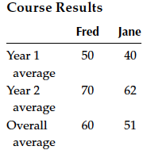
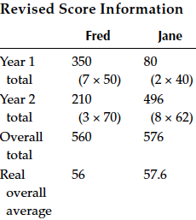
Use Correct Sample Weighting in Averages!
The ignored cause here is number of course modules, taken each year by students Fred and Jane, which are used to calculate year averages with incorrect sample weighting resulting in a higher score for Fred, rather than course averages over all 10 modules (taking average of the average makes you loose valuable information!)
This an example of causal models and a System approach to analyze the information.

Slide 31
Confidence Intervals Normal Distribution Case

Slide 32
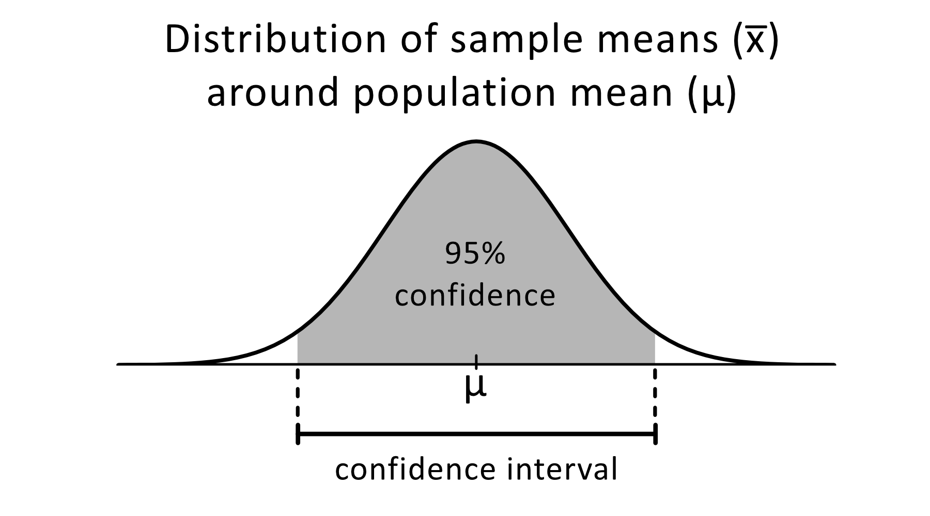
Confidence Interval to Model Uncertainty
Consider a sample x₁, x₂, …x_{n} from the distribution of X with population parameter θ.
The probability that θ is within [θ_{l}, θ_{u}] is the 1–α confidence interval of θ for a specific significance level, α
P[θ_{l}(x₁, x₂, …) < θ < θ_{u}(x₁, x₂, …)] = 1–α
The endpoints l(lower) and u(upper) are the lower and upper confidence limits of θ
Confidence limits can also be one sided: θ < θ_{u} or θ > θ_{l} for upper or lower one-sided limit

Slide 33
Confidence Interval Interpretation
Given a series of tests of samples drawn randomly from the same distribution, if the same confidence interval is calculated for each sample, the confidence interval will contain the true value of θ with confidence level 1– α, where the Pr of the sample to be outside the confidence interval = α .
Note that the larger the significance level α the smaller the 1– α and the narrower the confidence interval and vice versa.
Notes:
1-alpha is the probability the value will lie within the confidence interval. So larger the value of 1-alpha, the greater the chance it will lie within that range (and hence larger the span)

Slide 34
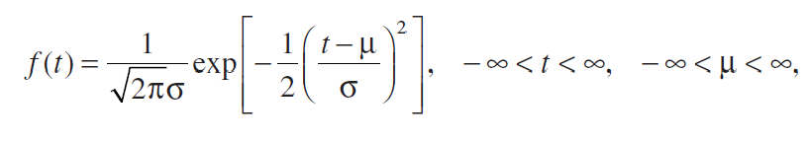
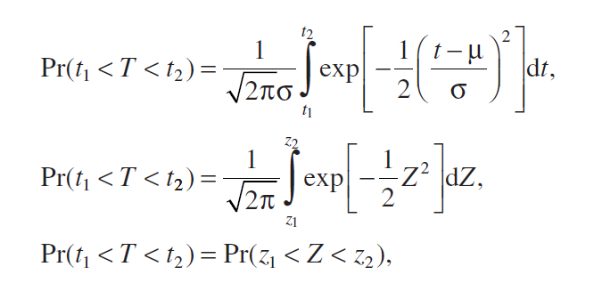
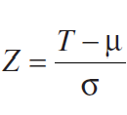
Mathematical formulation for Normal Dist.
Mathematical representation of the normal pdf:
Probability that the random variable t takes on a value between t₁ and t₂:
Values of Pr and Z obtained from standard tables.
where,

Slide 35
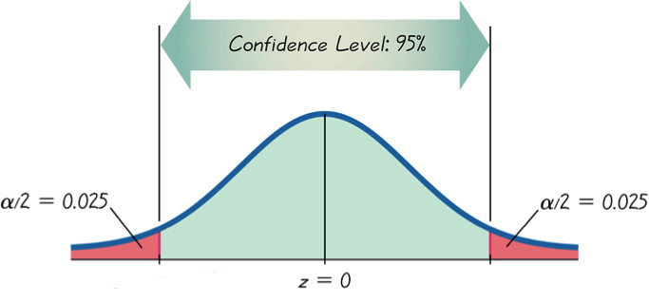
Significance Level α = 0.05
A wider interval represents a higher confidence level (smaller α)
Lower confidence limit
Upper confidence limit
f(z)
_{α= 0.05}
Confidence Interval 1–α
± 1 σ = 0.68
Acceptance Region
± 1.96 σ = 0.95
Z = -1
z
Z = 1
Z_{α/2} = – Φ⁻¹(1–α/2) = –1.96
Z_{1-α/2} = Φ⁻¹(1–α/2) = 1.96
1σ 68.3 %
2σ 95.5 %
3σ 99.7 %
Triola (adapted), 2007
Notes:
Complicated integration for the area under the curve that cannot be solved (no closed form). So the z term is used to simplify matters. Here, z is normally distributed with a mean of 0 and a std. dev of sigma. Table A1 provides cumulative probabilities of the standardized normal distribution. For various values of alpha, we can use the appendix table to determine z and vice versa.

Slide 36
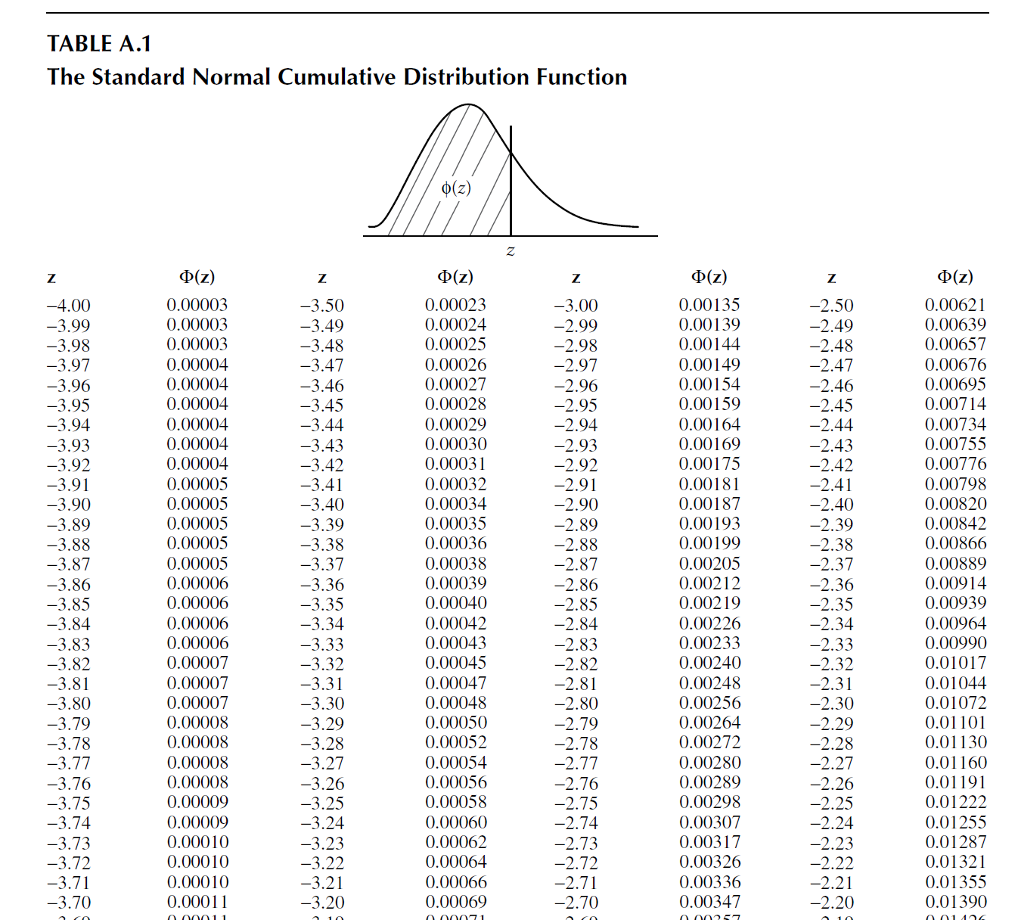
RERA, Table A1, pp 467
Total probability that the parameter Z’s value is less than z (shaded area)

Slide 37
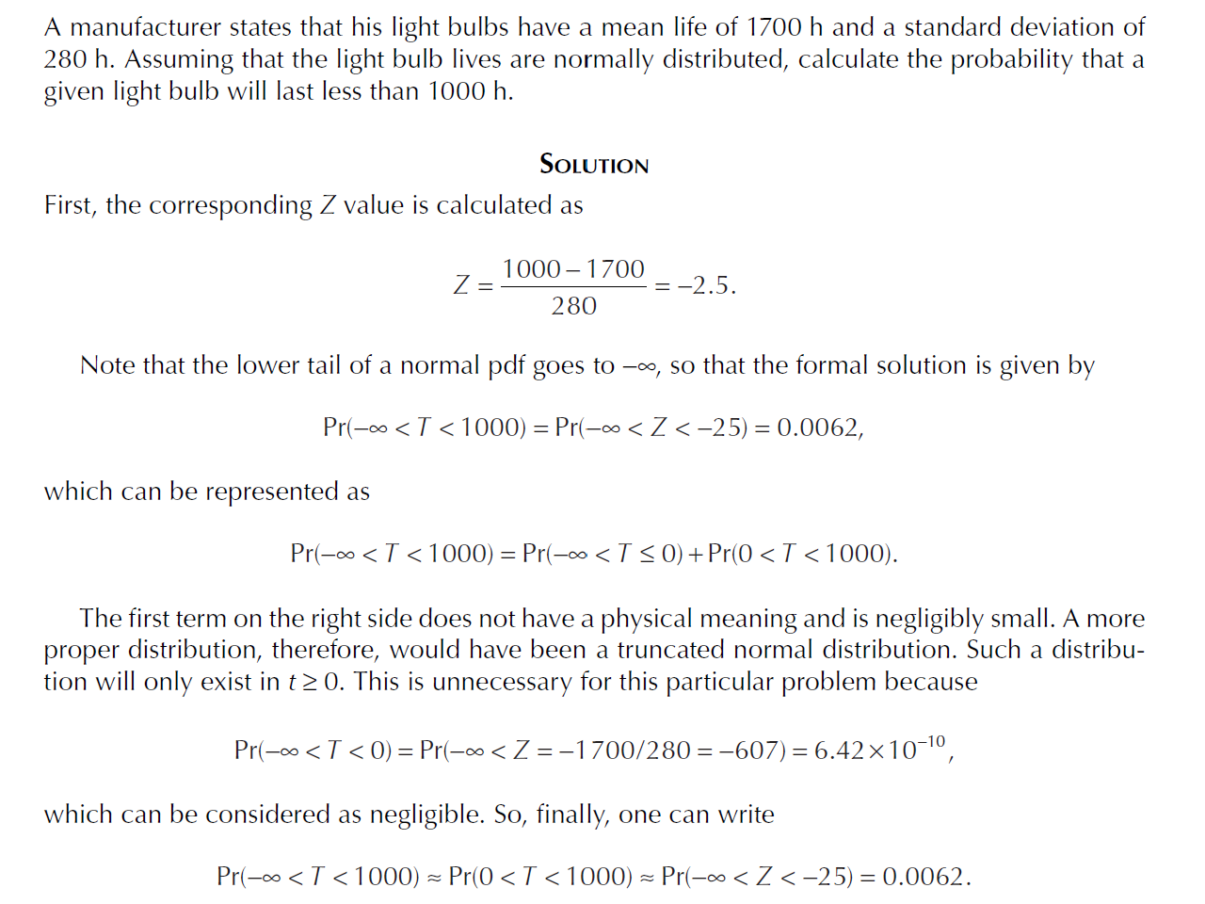
Normal Dist., Example
.

Slide 38
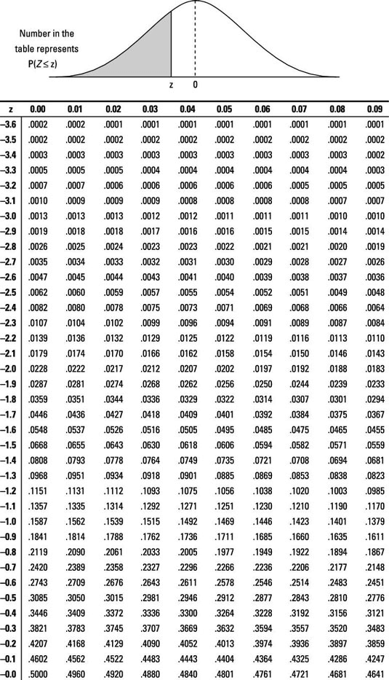
Satellite example
Consumption of jet fuel for maneuvering a satellite during one year is normally distributed with a mean of 10,000 hr and a std. deviation of 1000 hr.
What is the probability of maneuvering the satellite throughout a one-year mission (i.e. the probability you do NOT run out of fuel before 1-year)?

Slide 39
Types of Distributions: Discrete
Binomial
Random trials having 2 possible outcomes
Model failures on demand
Poisson
Random events dispersed in time/space with a constant intensity rate
Model number of failures over a given time/distance/space etc.

Slide 40
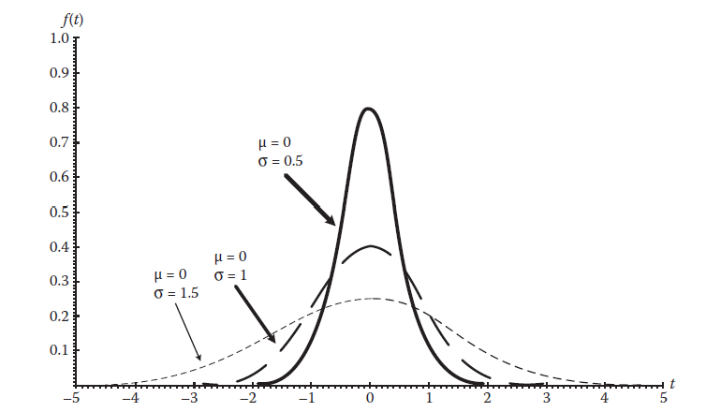
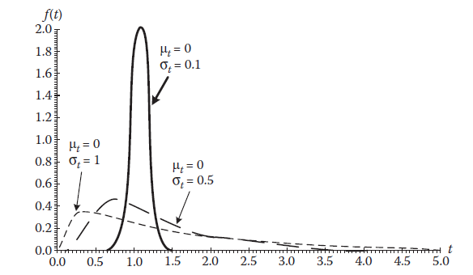
Types of Distributions: Continuous
Normal
Widely used for random variable
For large datasets
Lognormal
Logarithm of the random variable is normally (Gaussian) distributed
One major application: ability to represent a random variable (r.v.) that is the result of the multiplication of many independent r.v.s, or one that could vary by several orders of magnitude.

Slide 41
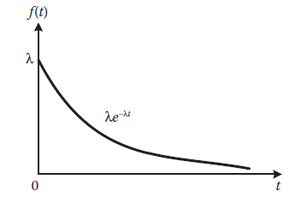
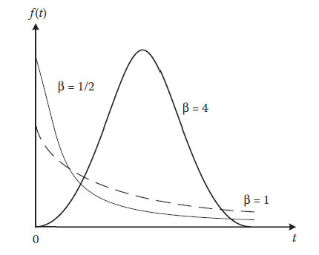
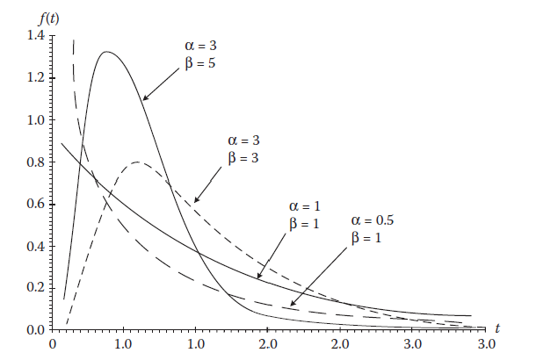
Types of Distributions: Continuous
Exponential
Most commonly used in reliability
Model time-to-failure with constant failure rate
Weibull
Shape and scale parameter
Model complex systems composed of multiple components that can fail individually
Gamma
Shape and scale parameter
Model system with successive failures that follow exponential distribution for failure
Systems subject to shocks that follow Poisson process

Slide 42
Satellite example

